Slide 1
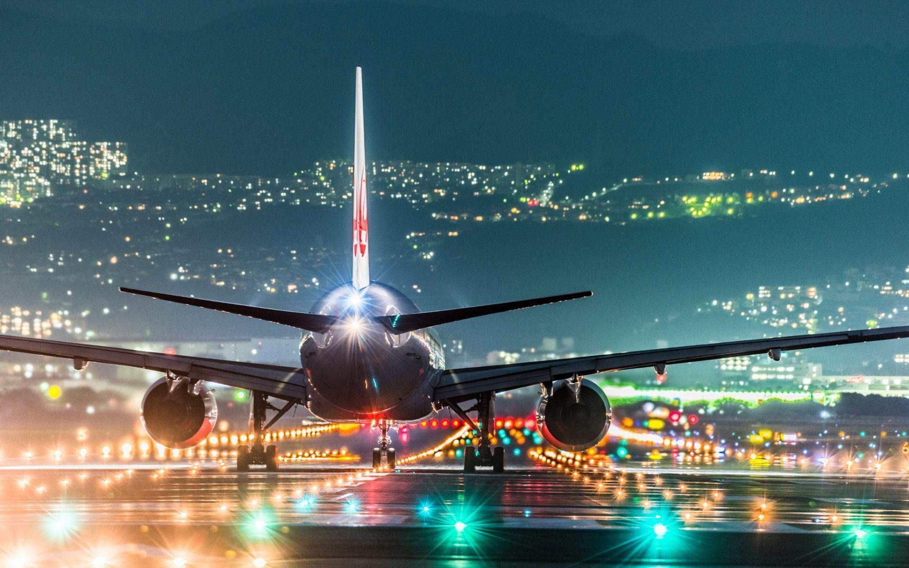
Satis
FACTORY
Invistico Airlines
Source: https://wallpapercave.com/airport-wallpapers

Slide 2
Company Profile
Mission
Invistico Airlines is a global company dedicated to providing air transportation services focused on customer satisfaction of the highest quality flight services and to maximize returns for the benefit of shareholders and employees
Establish Company
62 International Destination
32 Country
Airbus & Boeing
5 Continent
Flight Route
Airplane Type
Business Class
Business Class : IDR 15 - 70 Million
Economy Plus Class
Economy Plus Class : IDR 10 – 35 Million
Economy Class
Economy Class : IDR 2-15 Million
Product Services 1
Cabin Type
Ticket Price
Product Services
Nemo enim ipsam voluptatem quia voluptas sit aspernatur aut odit aut fugit, sed quia
Source: traveloka.com
Notes:
Images place via grey box, just right click and go to fill>Picture.

Slide 3
Table Of Content
Project Background
Preliminary Insight
Classification Model
Business Recommendation
Notes:
Images place via grey box, just right click and go to fill>Picture.

Slide 4
Problem
Goals
Since the dissatisfaction rate reached 45% of the total customers, Invistico Airlines needs to find the right solution to improve their services.
Invistico Airlines customers will have a pleasant experience and increase satisfaction customer.
How can Invistico Airlines improve the customer satisfaction rate?
Customer
Product
Brand
How is the customer segmentation of Invistico Airlines?
How is the level of customer satisfaction rate on invistico airlines service?.
How is the level of customer satisfaction rate on invistico airlines service?
What is the most influential service?
Which customer segment needs to be improved
How does Invistico Airlines provide a pleasant flying experience for this segment?
Business Metrics
Customer Satisfaction Rate
Business impact
‹#›

Slide 5
Table Of Content
Project Background
Preliminary Insight
Classification Model
Business Recommendation
Notes:
Images place via grey box, just right click and go to fill>Picture.

Slide 6
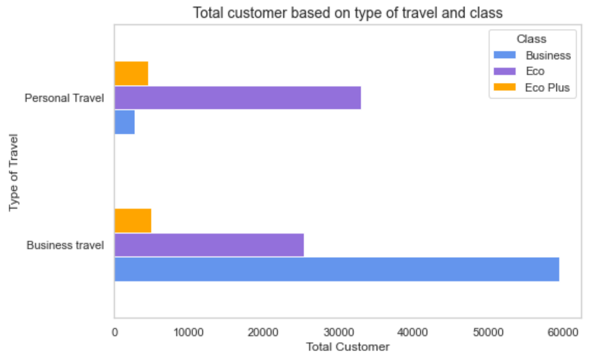
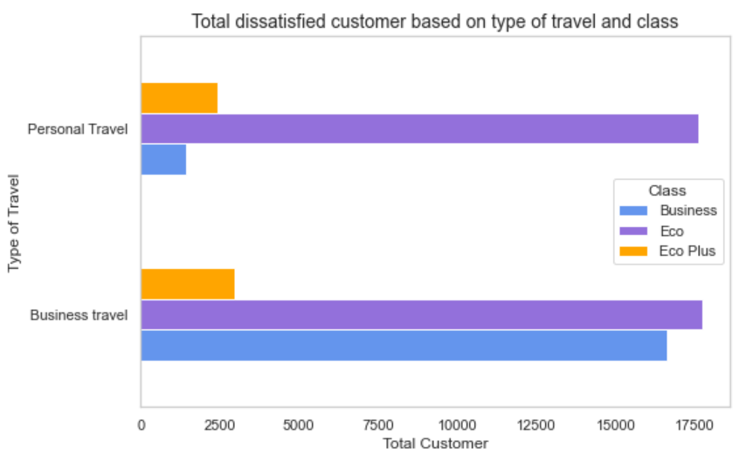
Segmentation Customer
1
Business travel – Business Class
1
Business travel – Economy Class
2
Personal travel – Economy Class
2
Personal travel – Economy Class
3
Business travel – Economy Class

Slide 7
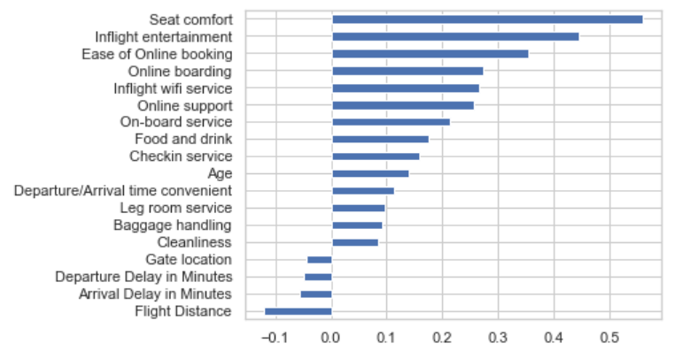
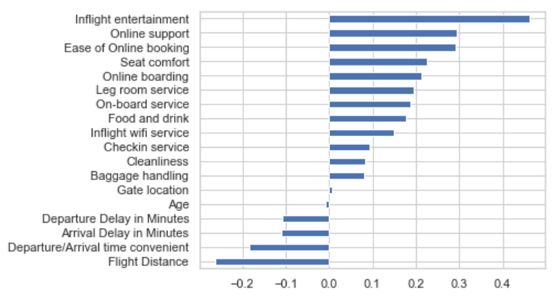
Consideration Factors
Business Travel – Eco Class
Personal Travel – Eco Class
Seat Comfort
Inflight Entertaiment

Slide 8
Table Of Content
Project Background
Preliminary Insight
Classification Model
Business Recommendation
Notes:
Images place via grey box, just right click and go to fill>Picture.

Slide 9





Understanding Dataset
Dataset Feature
Target Label
Satisfied
Dissatisfied

Slide 10
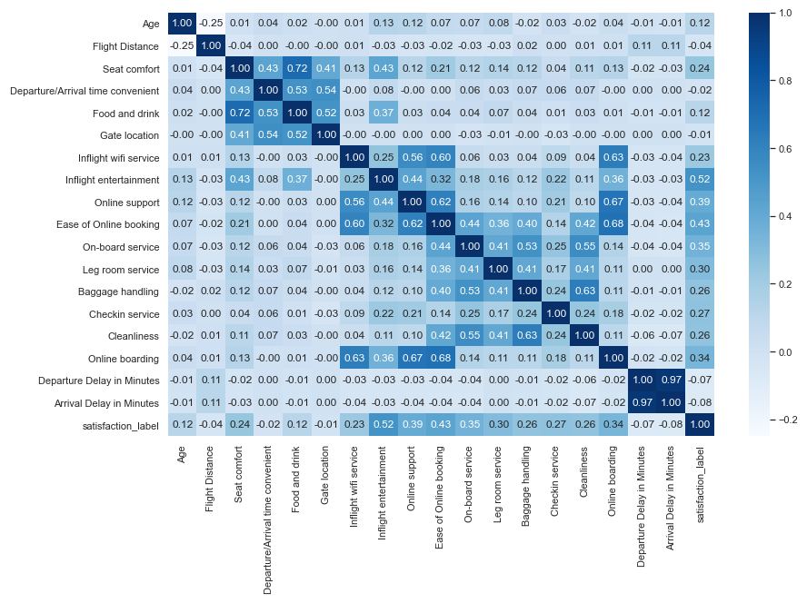
Feature Correlation
Strongest correlation towards satisfaction is Inflight entertainment and ease of online booking
D
C
Arrival delay & departure delay have strong correlation, and 1 feature will be discard on modelling step
B
Step A

Slide 11
Data Preprocessing
Missing Value
Drop missing value in Arrival Delay in Minutes
Replace 0 value from each services to mode value.
Outliers
Treatment outliers with log transform
Scaling
Use MinMaxScaler for data Flight Distance, Departure Delay in Minutes, Arrival Delay in Minutes.
One hot encoding for data categorical
Use one hot encoding for data Gender, customer type, type of travel, and class

Slide 12
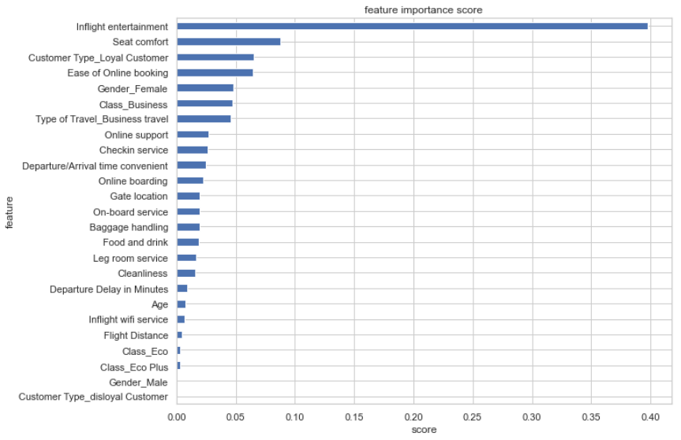
Classification Model Result
Eval Model
Logreg
KNN
DT
ADABoost
RF
XGBoost
Accuracy
0.85
0.91
0.93
0.88
0.96
0.96
Precision
0.86
0.93
0.94
0.89
0.97
0.97
Recall
0.88
0.90
0.94
0.89
0.95
0.95
F1 Score
0.87
0.91
0.94
0.89
0.96
0.96
AUC
0.85
0.91
0.93
0.88
0.96
0.96
Eval Model
RF
XGBoost
Hyperparameter Tuning XGBoost
Accuracy
0.96
0.96
max_depth
Min_child_weight
Gamma
Tree-method
Colsample-bytree
Eta
Lambda
alpha
Precision
0.96
0.97
Accuracy Score
Recall
0.95
0.96
Train
0.97
F1 Score
0.96
0.96
Test
0.96
AUC
0.96
0.96

Slide 13
Table Of Content
Project Background
Preliminary Insight
Classification Model
Business Recommendation
Notes:
Images place via grey box, just right click and go to fill>Picture.

Slide 14
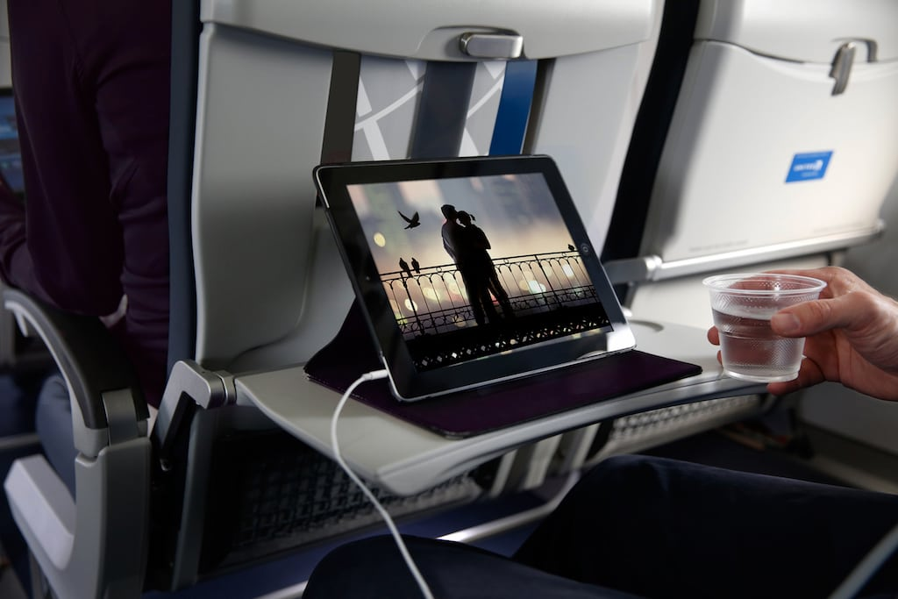
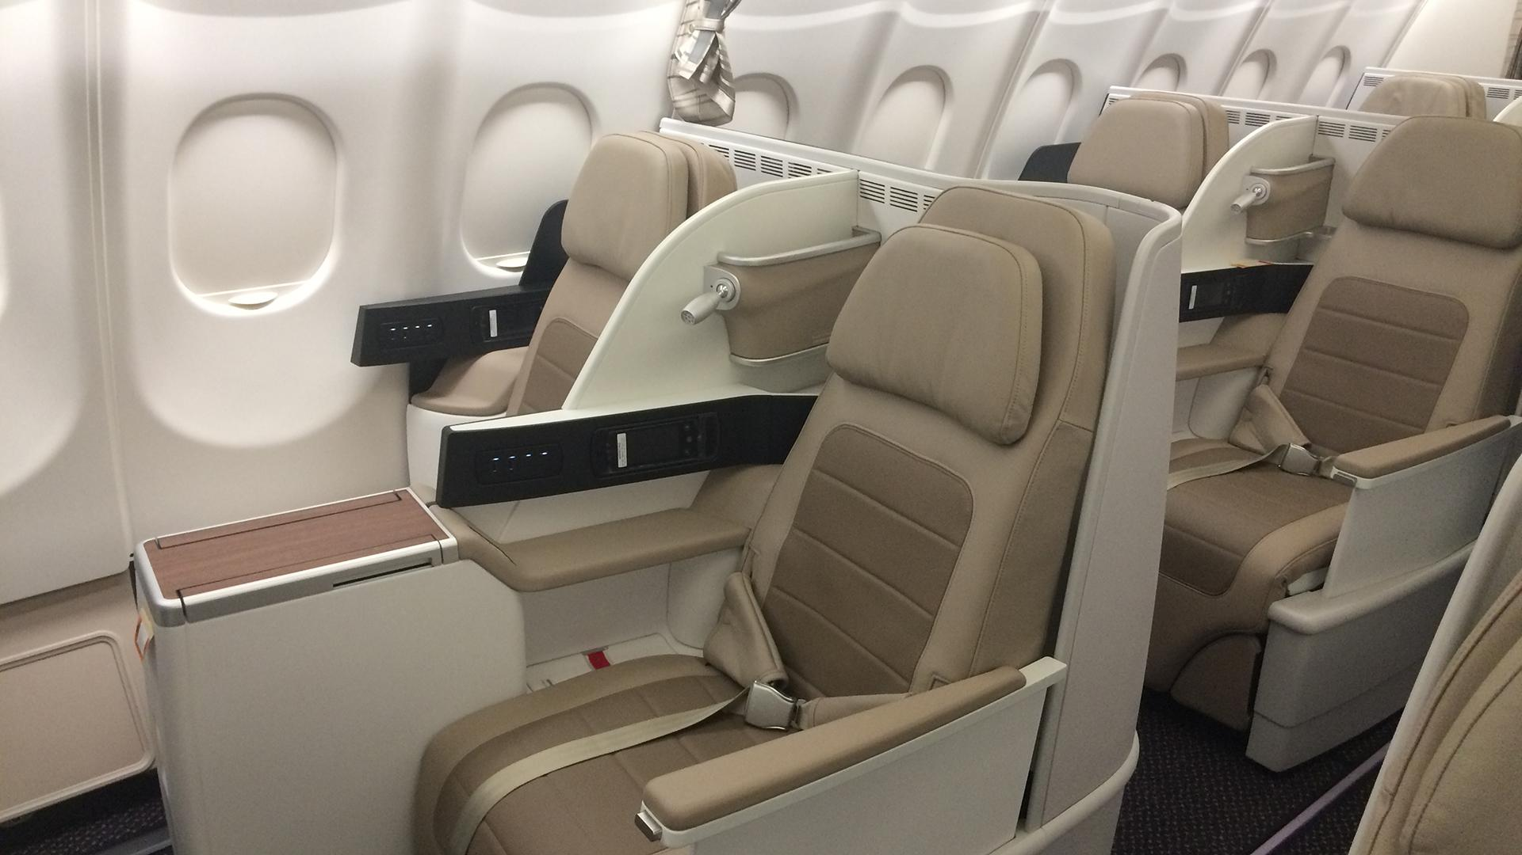
STRATEGY FOR IMPROVEMENT
Inflight Entertaiment
Seat comfort
Tablet PC
Netflix
Spotify
Games & Apps
Renew seat cushion with full foam

Slide 15


COST ANALYSIS
Table Seat Plane Eco Class
Boeing
26 Business
367 Economy
NO
Airplane Type
Eco Seat
Total Airplane
Result
1
Boeing
367
31
11377
Airbus
36 Business
215 Economy
2
Airbus
215
31
6665
TOTAL
18042
Table Cost of Inflight Entertaiment and Seat Comfort
NO
Service Type
Price
Total
Result
Info
Source info
1
Movie, TV Show
Rp 186.000
18042
Rp 3.355.812.000
Netflix
netflix.com
2
Music
Rp 49.990
18042
Rp 901.919.580
Spotify
spotify.com
3
Games & Apps
0
0
-
Google Play Store
4
Tablet PC
Rp 5.990.000
18042
Rp 108.071.580.000
Samsung Galaxy Tab S6 Lite
Iprice.co.id
5
Seat cushion full foam
Rp 4.500.000
18042
Rp 81.189.000
Mbtech Career
tokopedia.com
TOTAL
Rp 193.518.311.580
*https://www.garuda-indonesia.com/id/id/garuda-indonesia-experience/fleets/seat-map

Slide 16
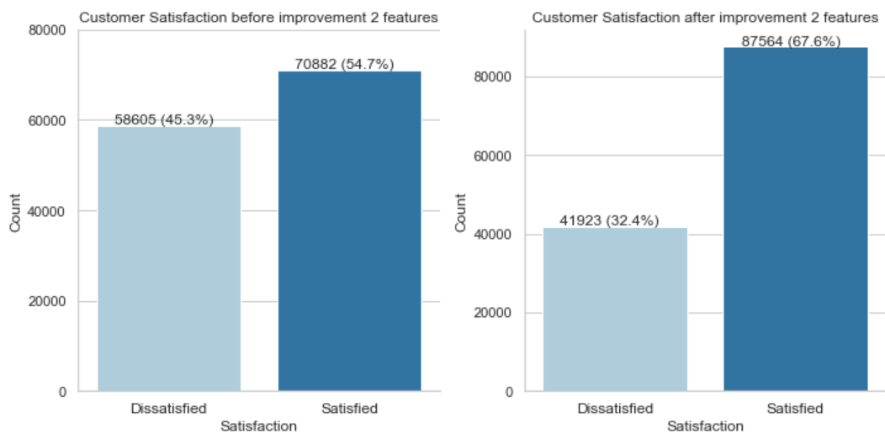
IMPACT ON OVERALL CUSTOMER SATISFACTION
Ashley Kayla
CEO- & Co Founder
Sed ut perspiciatis unde omnis iste natus error sit either voluptatem accusantium doloremque give to laudantium, totam rem aperiam, eaque ipsa quae ab illo
Ashley Kayla
CEO- & Co Founder
accusantium doloremque ipsa quae ab illo
Assuming customer on Business Travel-Eco Class satisfied with improvement of seat comfort
** Assuming customer on Personal Travel-Eco Class satisfied with improvement of inflight entertaiment
Notes:
Images place via grey box, just right click and go to fill>Picture.

Slide 17
Satis
FACTORY
Thank You

